Slide 1
Flash Memory 原理与架构
李碧洲 楼冰泳

Slide 2
简介
什么是Flash Memory
Flash Memory原理
Flash Memory性能要求
  Flash结构对性能的影响
  Flash模块对性能的影响
Flash Memory工作步骤
  读取操作
  编程操作
  擦除操作

Slide 3
什么是Flash？
Flash Memory，Flash ROM，Flash EEPROM 或称闪存，是从EEPROM演变而来，1980年代开始出现。
Flash与EEPROM的区别是，每当要擦除時，Flash是以Sector为单位，而EEPROM是以byte为单位。Flash其名字来自于一次性进行删除的特点。

Slide 4
Flash EEPROM
控制栅
浮栅
擦除
隧道氧化层(100Å)
n
+
源极
n
+
漏极
写入
D
p-
衬底
G
Flash的典型工作模式
S
Schematic 符号

Slide 5
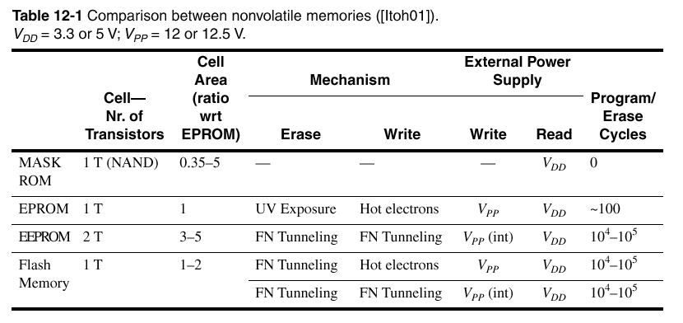
Flash与其它非易失Memory特征比较

Slide 6
Flash 与 EEPROM的特性比较
Flash具有EEPROM电擦写式的特点，还具有低功耗、密度高、可靠性高、可擦除、可重写、可重复编程等优点
Flash与EEPROM相比，写入快、耗电量低。但与DRAM和SRAM相比，写入速度慢、耗电量高。这个问题是由闪存结构产生的。

Slide 7
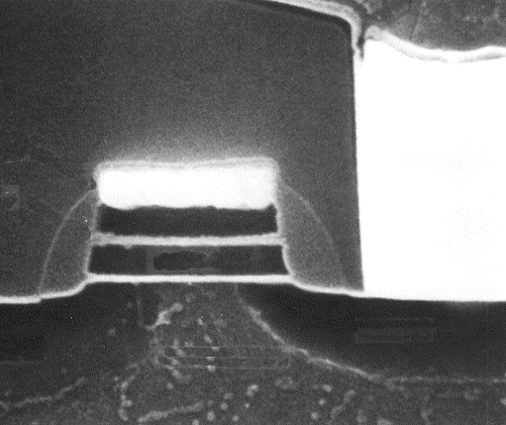
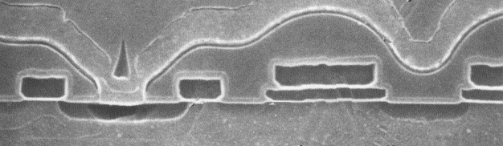
Flash和EEPROM的截面图比较
Flash
EEPROM
bitline
bitline
wordline
wordline
sourceline
progline
sourceline
1T
2T
Flash
EEPROM
Courtesy Intel

Slide 8
Flash Memory工作原理（编程）
20 V
0 V
5 V
10 V
5 V
20 V
-
5 V
0 V
-
2.5 V
5 V
S
D
S
D
S
D
电子注入
编程高电压去掉后留下电子
编程的结果是
更高的
V
T
.
Flash浮栅编程过程

Slide 9
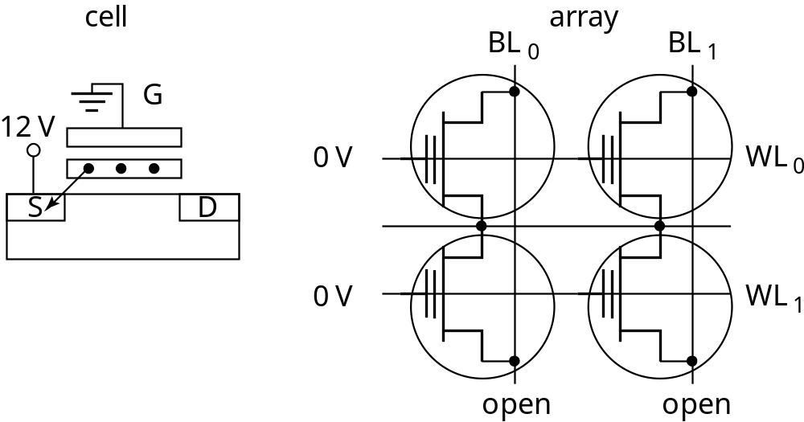
Flash Memory工作原理（擦除）
源极高电压
Pn结击穿
负电压擦除

Slide 10
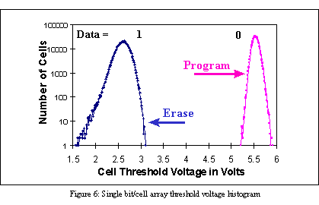
阈值电压分布

Slide 11
载流子转移机制
沟道热电子注入(CHEI)
DAHC Injection
BBHC
Fowler-Nordheim (FN) 隧道效应

Slide 12
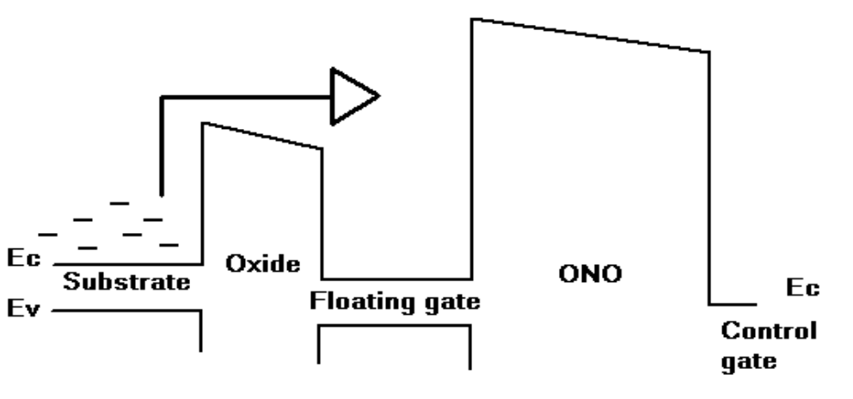
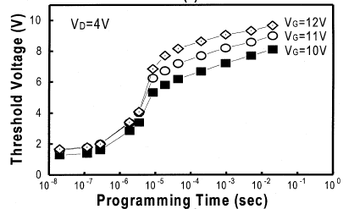
CHEI能带图

Slide 13
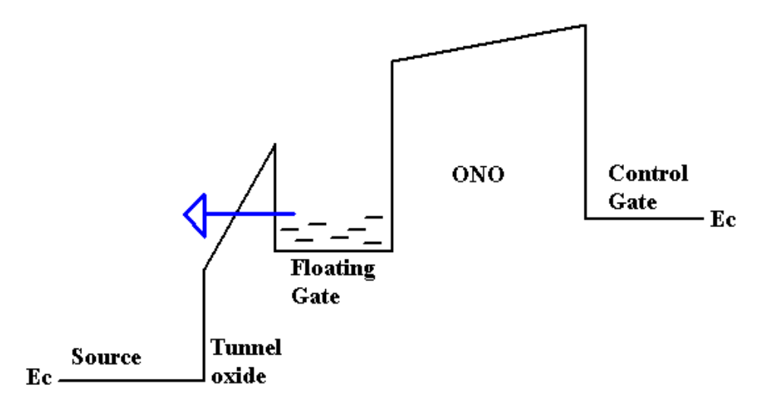
Fowler-Nordheim FN隧道效应能带图
I
-10 V
V
GD
10 V
Fowler-Nordheim
I-V 特性

Slide 14
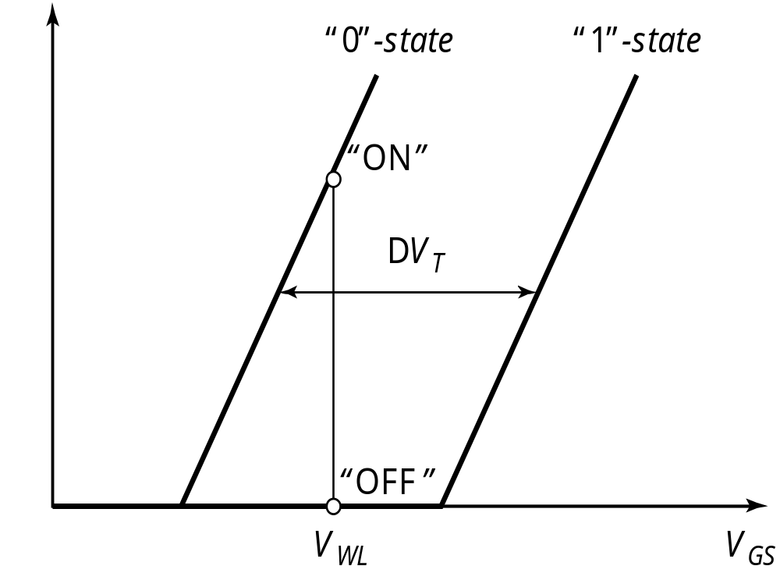
典型情况下Flash单元阈值电压的变化
reference

Slide 15
检测放大器(Sense Amplifier)
V_{cc}
V_{cc}
R_{A}
R_{R}
Sense Amp
V_{Out}
I_{cell}
I_{ref} ~ μA
1V
1V
V_{Wordline}=5V
阵列
单元
参考
单元
5V
Flash 单元
参考Flash 单元

Slide 16
Flash Memory的性能要求
单一电压供电（3V/5V）
低电压，功耗小
与NMOS或CMOS工艺兼容
容量大
读写速度快
受温度、工艺的影响小
寿命

Slide 17
Flash Memory结构对性能的影响
AND、NAND、NOR和DiNOR
NOR和DiNOR的特点为相对电压低、随机读取快、功耗低、稳定性较高
NAND和AND特点则是容量大、回写速度快、芯片面积小。

Slide 18
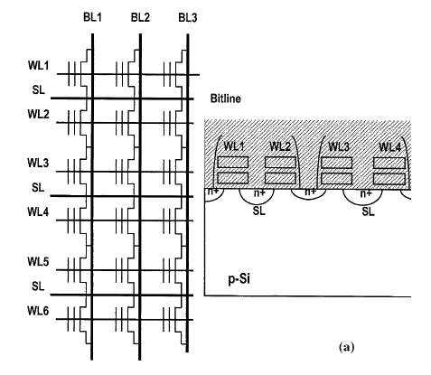
NOR型Flash的电路图与截面图

Slide 19
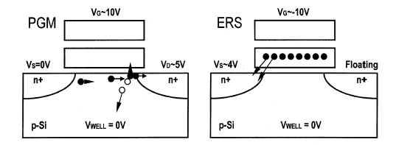
NOR型Flash的原理
编程操作利用漏极的
CHEI效应
擦除操作利用源极的
FN隧道效应

Slide 20
NOR Flash 擦除操作

Slide 21
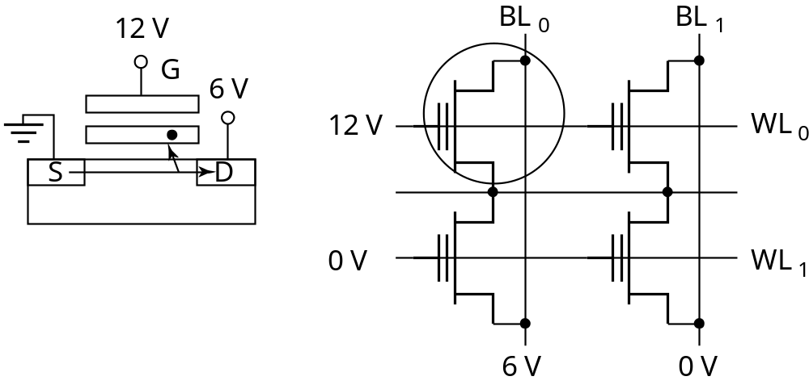
NOR Flash 写操作

Slide 22
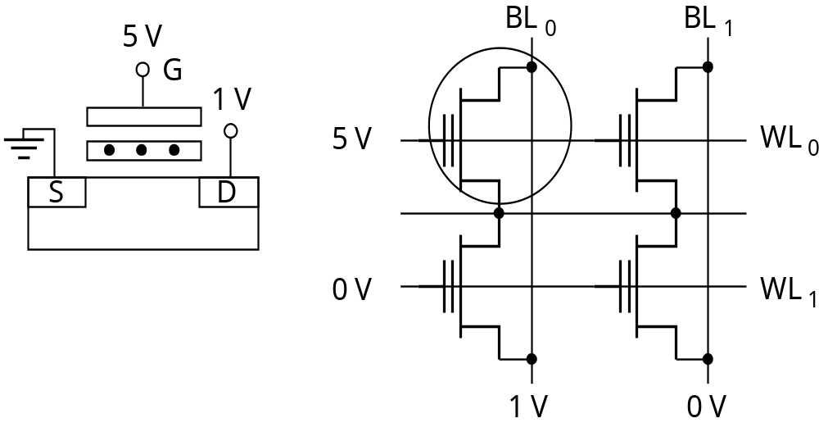
NOR Flash 读操作

Slide 23
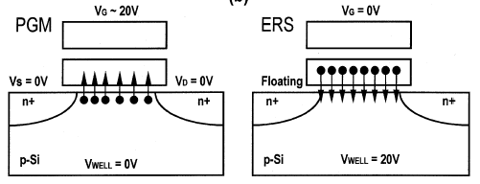
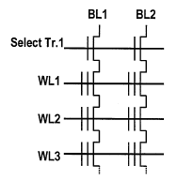
NAND型Flash的电路图及其原理
编程与擦除操作都是利用沟道区的FN隧道效应

Slide 24
NAND Flash Memory Layout
选择管
Word lines
有源区
STI
Bit line 触点
Source line 触点

Slide 25
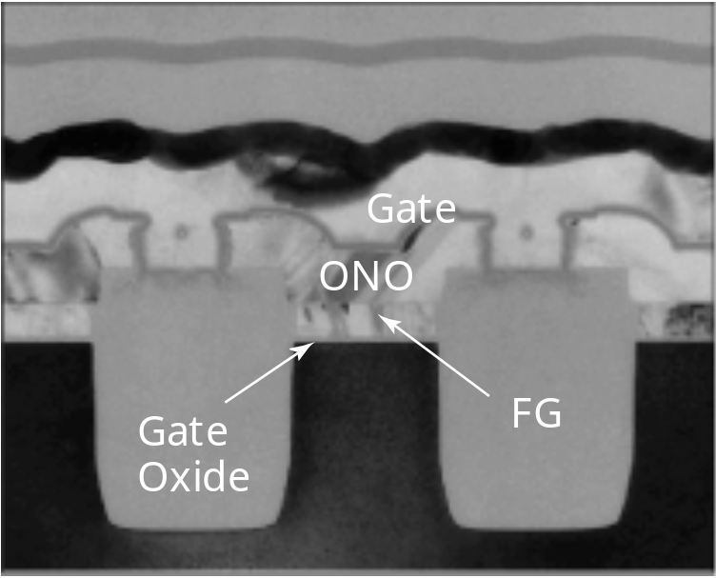
NAND Flash Memory的电路图与截面图
Word line(poly)
Unit Cell
Source line
(Diff. Layer)

Slide 26
低电压下阈值电压的变化
reference
I_{D}
“0” State
“1” State
V_{GS}

Slide 27
Flash Memory关键模块对性能的影响
状态机FSM（控制读、写和擦除等操作）
时钟产生电路
正负电荷泵（利用单一电压Vcc产生高电压）
电压调节电路（减小温度、工艺的影响）
检测放大器（低电压)
译码电路
驱动电路（大容量）
缓存（提高访问速度）

Slide 28
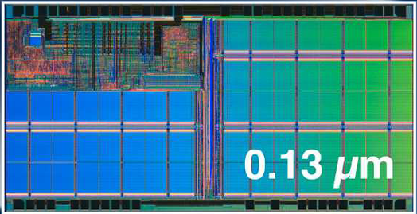
Flash Memory关键模块
Address/Control Pads
User
Interface
Positive & Negative
Pumps
32KW
Block
Sense Amps
Pre Sense Amps
Local Y decoder
X decoder
Y decoder
I/O Pads

Slide 29
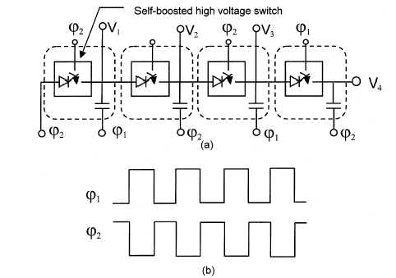
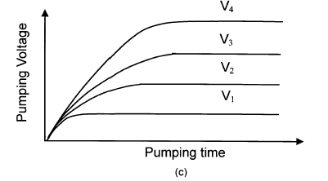
电荷泵
利用单一电压Vcc产生高电压

Slide 30
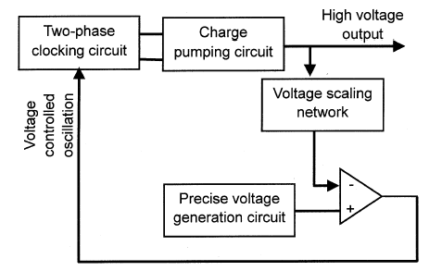
电压调节
（减小温度、
工艺的影响）

Slide 31
Flash结构框图
Power-Up
Circuit &
Flash Pair
Negative
Pump
Positive
Pumps
CAMs
Source
Switches
Block
Select (Z)
Row
Decode
(X)
Flash Array
Row & Col Redundancy
Address
Data
User
Interface
ATD
Read SM
FACEFF
Column Decode
(Y)
LD Bits
Control
Program Loads
X16
Sensing
X16
Sensing
X64
Output
4X16
Output
X16

Slide 32
上电
Power-Up
Circuit &
Flash Pair
Negative
Pump
Positive
Pumps
CAMs
Source
Switches
Block
Select (Z)
Row
Decode
(X)
Flash Array
Row & Col Redundancy
Address
Data
User
Interface
ATD
Read SM
FACEFF
Column Decode
(Y)
LD Bits
Control
Program Loads
X16
Sensing
X16
Sensing
X64
Output
4X16
Output
X16

Slide 33
读取操作
读取：命令
读取：译码
读取：检测
读取：输出

Slide 34
读取：命令
Power-Up
Circuit &
Flash Pair
Negative
Pump
Positive
Pumps
CAMs
Source
Switches
Block
Select (Z)
Row
Decode
(X)
Flash Array
Row & Col Redundancy
Address
Data
User
Interface
ATD
Read SM
FACEFF
Column Decode
(Y)
LD Bits
Control
Program Loads
X16
Sensing
X16
Sensing
X64
Output
4X16
Output
X16

Slide 35
读取：译码
Power-Up
Circuit &
Flash Pair
Negative
Pump
Positive
Pumps
CAMs
Source
Switches
Block
Select (Z)
Row
Decode
(X)
Flash Array
Row & Col Redundancy
Address
Data
User
Interface
ATD
Read SM
FACEFF
Column Decode
(Y)
LD Bits
Control
Program Loads
X16
Sensing
X16
Sensing
X64
Output
4X16
Output
X16

Slide 36
读取：检测
Power-Up
Circuit &
Flash Pair
Negative
Pump
Positive
Pumps
CAMs
Source
Switches
Block
Select (Z)
Row
Decode
(X)
Flash Array
Row & Col Redundancy
Address
Data
User
Interface
ATD
Read SM
FACEFF
Column Decode
(Y)
LD Bits
Control
Program Loads
X16
Sensing
X16
Sensing
X64
Output
4X16
Output
X16

Slide 37
读取：输出
Power-Up
Circuit &
Flash Pair
Negative
Pump
Positive
Pumps
CAMs
Source
Switches
Block
Select (Z)
Row
Decode
(X)
Flash Array
Row & Col Redundancy
Address
Data
User
Interface
ATD
Read SM
FACEFF
Column Decode
(Y)
LD Bits
Control
Program Loads
X16
Sensing
X16
Sensing
X64
Output
4X16
Output
X16

Slide 38
编程操作
编程：开始
编程：脉冲
编程：验证
编程：结束

Slide 39
编程：命令
Power-Up
Circuit &
Flash Pair
Negative
Pump
Positive
Pumps
CAMs
Source
Switches
Block
Select (Z)
Row
Decode
(X)
Flash Array
Row & Col Redundancy
Address
Data
User
Interface
ATD
Read SM
FACEFF
Column Decode
(Y)
LD Bits
Control
Program Loads
X16
Sensing
X16
Sensing
X64
Output
4X16
Output
X16

Slide 40
编程：开始
Power-Up
Circuit &
Flash Pair
Negative
Pump
Positive
Pumps
CAMs
Source
Switches
Block
Select (Z)
Row
Decode
(X)
Flash Array
Row & Col Redundancy
Address
Data
User
Interface
ATD
Read SM
FACEFF
Column Decode
(Y)
LD Bits
Control
Program Loads
X16
Sensing
X16
Sensing
X64
Output
4X16
Output
X16

Slide 41
编程：脉冲
V_{t}
Power-Up
Circuit &
Flash Pair
Negative
Pump
Positive
Pumps
CAMs
Source
Switches
Block
Select (Z)
Row
Decode
(X)
Flash Array
Row & Col Redundancy
Address
Data
User
Interface
ATD
Read SM
FACEFF
Column Decode
(Y)
LD Bits
Control
Program Loads
X16
Sensing
X16
Sensing
X64
Output
4X16
Output
X16

Slide 42
编程：验证
X
V_{t}
Power-Up
Circuit &
Flash Pair
Negative
Pump
Positive
Pumps
CAMs
Source
Switches
Block
Select (Z)
Row
Decode
(X)
Flash Array
Row & Col Redundancy
Address
Data
User
Interface
ATD
Read SM
FACEFF
Column Decode
(Y)
LD Bits
Control
Program Loads
X16
Sensing
X16
Sensing
X64
Output
4X16
Output
X16

Slide 43
编程：结束
Power-Up
Circuit &
Flash Pair
Negative
Pump
Positive
Pumps
CAMs
Source
Switches
Block
Select (Z)
Row
Decode
(X)
Flash Array
Row & Col Redundancy
Address
Data
User
Interface
ATD
Read SM
FACEFF
Column Decode
(Y)
LD Bits
Control
Program Loads
X16
Sensing
X16
Sensing
X64
Output
4X16
Output
X16

Slide 44
擦除操作
擦除：开始
擦除：前期脉冲
擦除：前期验证
擦除：脉冲
擦除：验证
擦除：后期擦除
擦除：后期验证
擦除：结束

Slide 45
擦除：命令
Power-Up
Circuit &
Flash Pair
Negative
Pump
Positive
Pumps
CAMs
Source
Switches
Block
Select (Z)
Row
Decode
(X)
Flash Array
Row & Col Redundancy
Address
Data
User
Interface
ATD
Read SM
FACEFF
Column Decode
(Y)
LD Bits
Control
Program Loads
X16
Sensing
X16
Sensing
X64
Output
4X16
Output
X16

Slide 46
擦除：开始
Power-Up
Circuit &
Flash Pair
Negative
Pump
Positive
Pumps
CAMs
Source
Switches
Block
Select (Z)
Row
Decode
(X)
Flash Array
Row & Col Redundancy
Address
Data
User
Interface
ATD
Read SM
FACEFF
Column Decode
(Y)
LD Bits
Control
Program Loads
X16
Sensing
X16
Sensing
X64
Output
4X16
Output
X16

Slide 47
擦除：前期脉冲
V_{t}
Power-Up
Circuit &
Flash Pair
Negative
Pump
Positive
Pumps
CAMs
Source
Switches
Block
Select (Z)
Row
Decode
(X)
Flash Array
Row & Col Redundancy
Address
Data
User
Interface
ATD
Read SM
FACEFF
Column Decode
(Y)
LD Bits
Control
Program Loads
X16
Sensing
X16
Sensing
X64
Output
4X16
Output
X16

Slide 48
擦除：前期验证
V_{t}
Power-Up
Circuit &
Flash Pair
Negative
Pump
Positive
Pumps
CAMs
Source
Switches
Block
Select (Z)
Row
Decode
(X)
Flash Array
Row & Col Redundancy
Address
Data
User
Interface
ATD
Read SM
FACEFF
Column Decode
(Y)
LD Bits
Control
Program Loads
X16
Sensing
X16
Sensing
X64
Output
4X16
Output
X16

Slide 49
擦除：脉冲
V_{t}
Power-Up
Circuit &
Flash Pair
Negative
Pump
Positive
Pumps
CAMs
Source
Switches
Block
Select (Z)
Row
Decode
(X)
Flash Array
Row & Col Redundancy
Address
Data
User
Interface
ATD
Read SM
FACEFF
Column Decode
(Y)
LD Bits
Control
Program Loads
X16
Sensing
X16
Sensing
X64
Output
4X16
Output
X16

Slide 50
擦除：验证
V_{t}
Power-Up
Circuit &
Flash Pair
Negative
Pump
Positive
Pumps
CAMs
Source
Switches
Block
Select (Z)
Row
Decode
(X)
Flash Array
Row & Col Redundancy
Address
Data
User
Interface
ATD
Read SM
FACEFF
Column Decode
(Y)
LD Bits
Control
Program Loads
X16
Sensing
X16
Sensing
X64
Output
4X16
Output
X16

Slide 51
擦除：后期脉冲
V_{t}
Power-Up
Circuit &
Flash Pair
Negative
Pump
Positive
Pumps
CAMs
Source
Switches
Block
Select (Z)
Row
Decode
(X)
Flash Array
Row & Col Redundancy
Address
Data
User
Interface
ATD
Read SM
FACEFF
Column Decode
(Y)
LD Bits
Control
Program Loads
X16
Sensing
X16
Sensing
X64
Output
4X16
Output
X16

Slide 52
擦除：后期验证
V_{t}
Power-Up
Circuit &
Flash Pair
Negative
Pump
Positive
Pumps
CAMs
Source
Switches
Block
Select (Z)
Row
Decode
(X)
Flash Array
Row & Col Redundancy
Address
Data
User
Interface
ATD
Read SM
FACEFF
Column Decode
(Y)
LD Bits
Control
Program Loads
X16
Sensing
X16
Sensing
X64
Output
4X16
Output
X16

Slide 53
擦除：结束
V_{t}
Power-Up
Circuit &
Flash Pair
Negative
Pump
Positive
Pumps
CAMs
Source
Switches
Block
Select (Z)
Row
Decode
(X)
Flash Array
Row & Col Redundancy
Address
Data
User
Interface
ATD
Read SM
FACEFF
Column Decode
(Y)
LD Bits
Control
Program Loads
X16
Sensing
X16
Sensing
X64
Output
4X16
Output
X16

Slide 54
结束
谢谢！

